Slide 1
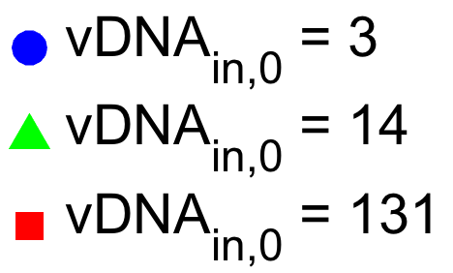
vDNA_{tot}
(genomes/cell)
Time (hpi)

Slide 2
vDNA_{tot}
(genomes/cell)
Time (hpi)

Slide 3
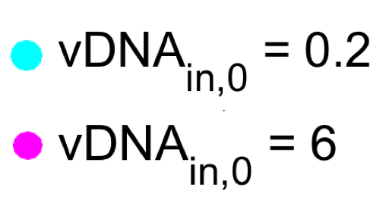
vDNA_{tot}
(genomes/cell)
Time (hpi)

Slide 4
vDNA_{tot}
(genomes/cell)
vDNA_{in,0}
(genomes/cell)
Time (hpi)

Slide 5
vDNA_{rep}
(genomes/cell)
vDNA_{in,0}
genomes/cell)
Time (hpi)

Slide 6
vDNA_{in}
(genomes/cell)
vDNA_{in,0}
(genomes/cell)
Time (hpi)

Slide 7
Maximal vDNA_{rep}
(genomes/cell)
vDNA_{in,0}
(genomes/cell)

Slide 8
t₅₀ for vDNA_{rep}
(hpi)
vDNA_{in,0}
(genomes/cell)

Slide 9
Hill Coefficient for vDNA_{rep}
vDNA_{in,0}
(genomes/cell)

Slide 10
Tp5_{1,tot}
(A.U.)
Time (hpi)

Slide 11
Tp5_{1,tot}
(A.U.)
Time (hpi)

Slide 12
Tp5_{1,tot}
(A.U.)
vDNA_{in,0}
(genomes/cell)
Time (hpi)

Slide 13
Tp5_{2,tot}
(A.U.)
Time (hpi)

Slide 14
Tp5_{2,tot}
(A.U.)
Time (hpi)

Slide 15
Tp5_{2,tot}
(A.U.)
vDNA_{in,0}
(genomes/cell)
Time (hpi)

Slide 16
Virus
(A.U.)
Time (hpi)

Slide 17
Virus
(A.U.)
Time (hpi)

Slide 18
Virus
(A.U.)
vDNA_{in,0}
(genomes/cell)
Time (hpi)

Slide 19
Tp5_{2,tot}
(A.U.)
Time (hpi)

Slide 20
Tp5_{2,tot}
(A.U.)
Time (hpi)

Slide 21
Virus (t = 96 hpi)/Virus (t = 24 hpi)
vDNA_{in,0}
(genomes/cell)

Slide 22
vDNA (t = 96 hpi)/vDNA_{in,0}
vDNA_{in,0}
(genomes/cell)

Slide 23
Tp5_{1,tot}
(A.U.)
vDNA_{tot}
(genomes/cell)
Time (hpi)

Slide 24
Tp5_{2,tot}
(A.U.)
vDNA_{tot}
(genomes/cell)
Time (hpi)

Slide 25
Virus
(A.U.)
vDNA_{tot}
(genomes/cell)
Time (hpi)

Slide 26
Virus
(I.U./mL)
vDNA_{in,0}
(genomes/cell)
Time (hpi)

